Slide 1


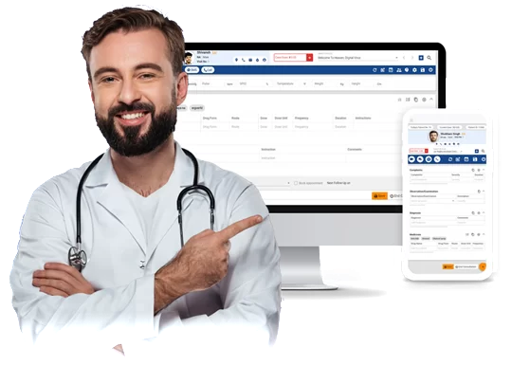
“ Clinic OPD Management System”
Submitted by: Arshad Shabbir Mulani
Submission type : Individual
Name: Arshad Shabbir Mulani
Batch : 12
LMS Id : arshadmulani.sitit@gmail.com
Program : Axis Fintech Program
Date: 25/05/2023
Github Link:- https://github.com/Arshad8786/SpringBootProject

Slide 2

Table of contents
Introduction
Project Overview
Architecture Design
User Interface Design
Back-end Development
Front-end Development
Testing
Deployment
Conclusion
Future Work
References
Appendices

Slide 3
Introduction
The Clinic OPD booking system is an essential requirement for our healthcare organization to
efficiently manage patient appointments and improve the overall patient experience.
The objective of this system is to streamline the patient booking process, reduce wait times, and
enhance the quality of care provided to patients.
spring dev tools which is developer tool, the aim is to try and improve the development time and changes and restart the application.
Thymeleaf for the frontend which supports html 5 and i have also added bootstrap in it.
So it is full stack app, where database is through SQL, frontend is through thymeleaf, backend in spring boot.

Slide 4
Project Overview
Patient Management: The system allows for the efficient management of patient records, including personal details, medical history, insurance. It provides a centralized repository for easy access and retrieval of patient information.
Doctor Management: The system allows for the efficient management of doctor records, including personal details and specialization .It provides a centralized repository for easy access and retrieval of patient information.
Appointment Scheduling: With the Clinic Management System, clinics can easily schedule and manage patient appointments. The system provides a user-friendly interface for creating, and canceling appointments .
User-Friendly Interface: The system incorporates a modern and intuitive user interface using Thymeleaf. It offers a seamless user experience, allowing clinic staff to navigate through different modules and perform tasks efficiently.
5.Integration with MySQL: The system uses MySQL as the relational database management system, providing reliable and efficient storage and retrieval of data. MySQL ensures data integrity, scalability, and high-performance for the Clinic Management System.

Slide 5
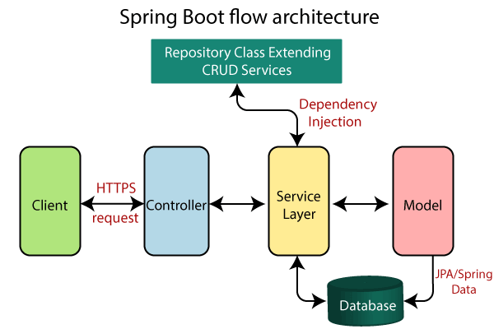
Architecture Design

Slide 6
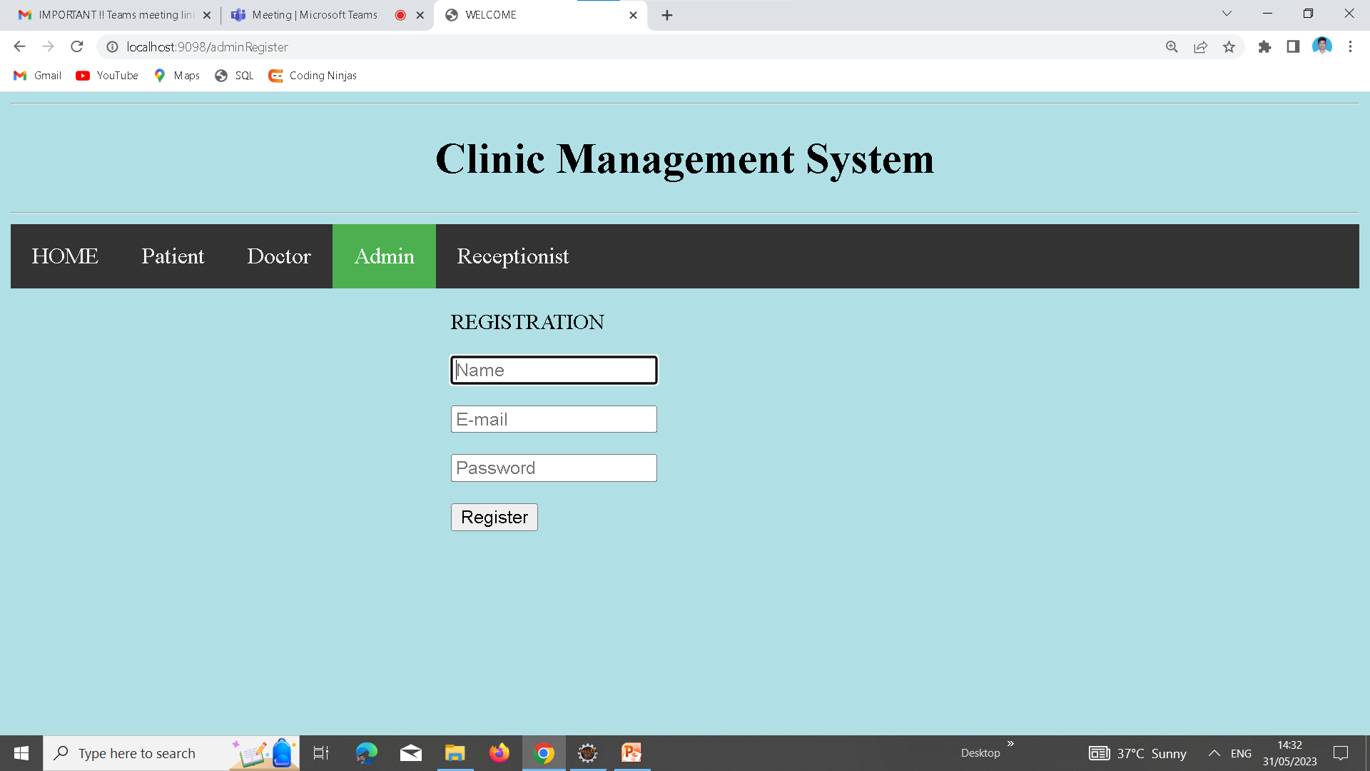
User Interface Design
Admin Registration page:-

Slide 7
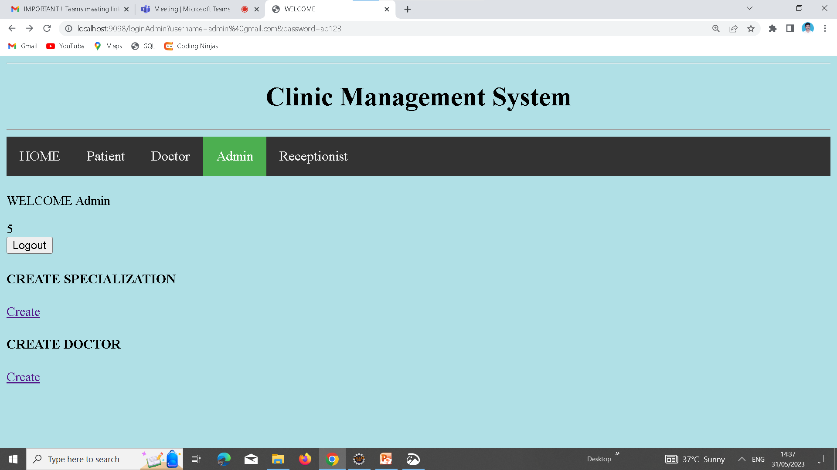
User Interface Design
Admin Home Page:-

Slide 8
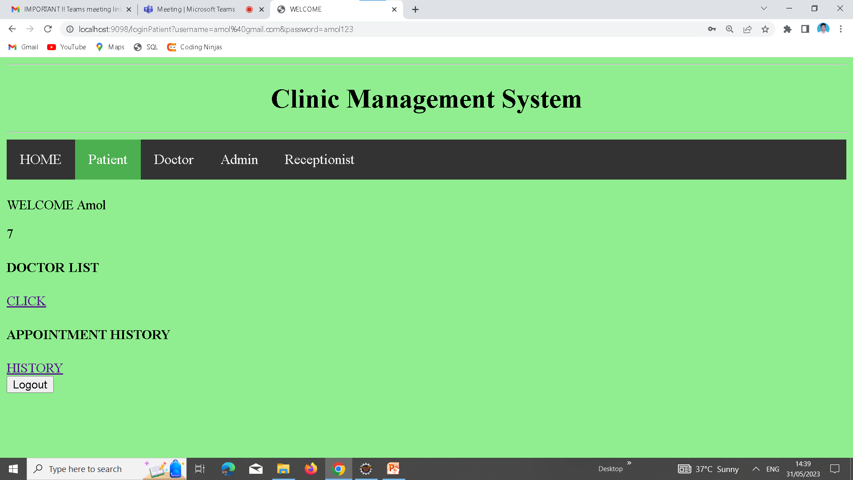
User Interface Design
Patient HomePage:-

Slide 9
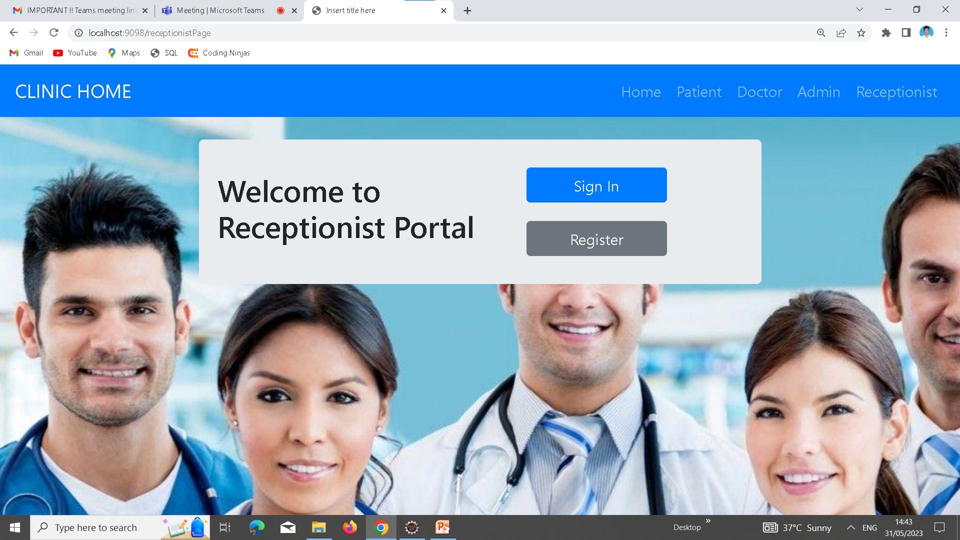
User Interface Design
Receptionist HomePage:-

Slide 10
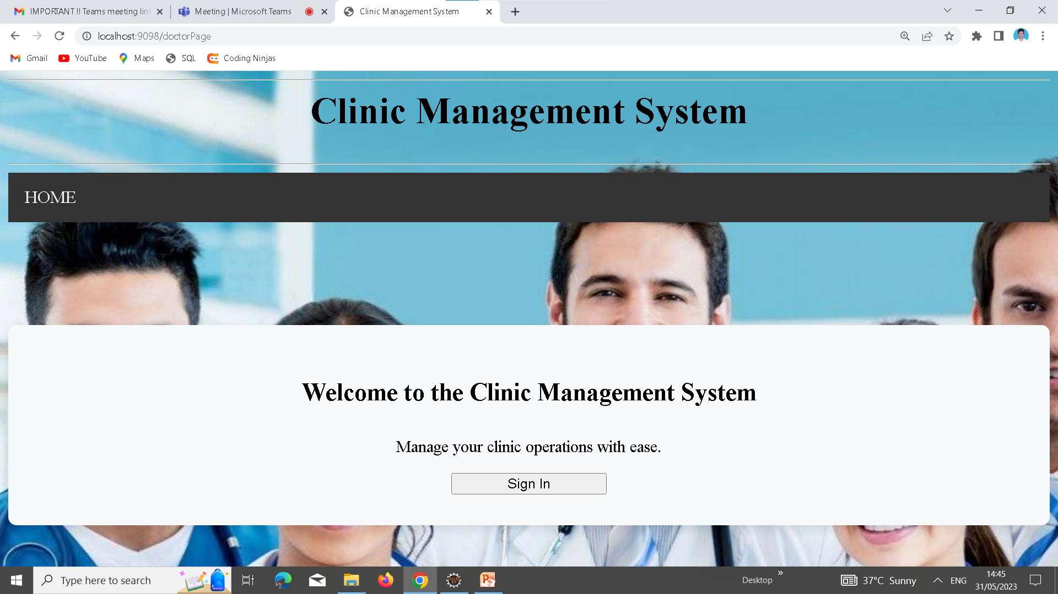
User Interface Design
Doctor HomePage:-

Slide 11
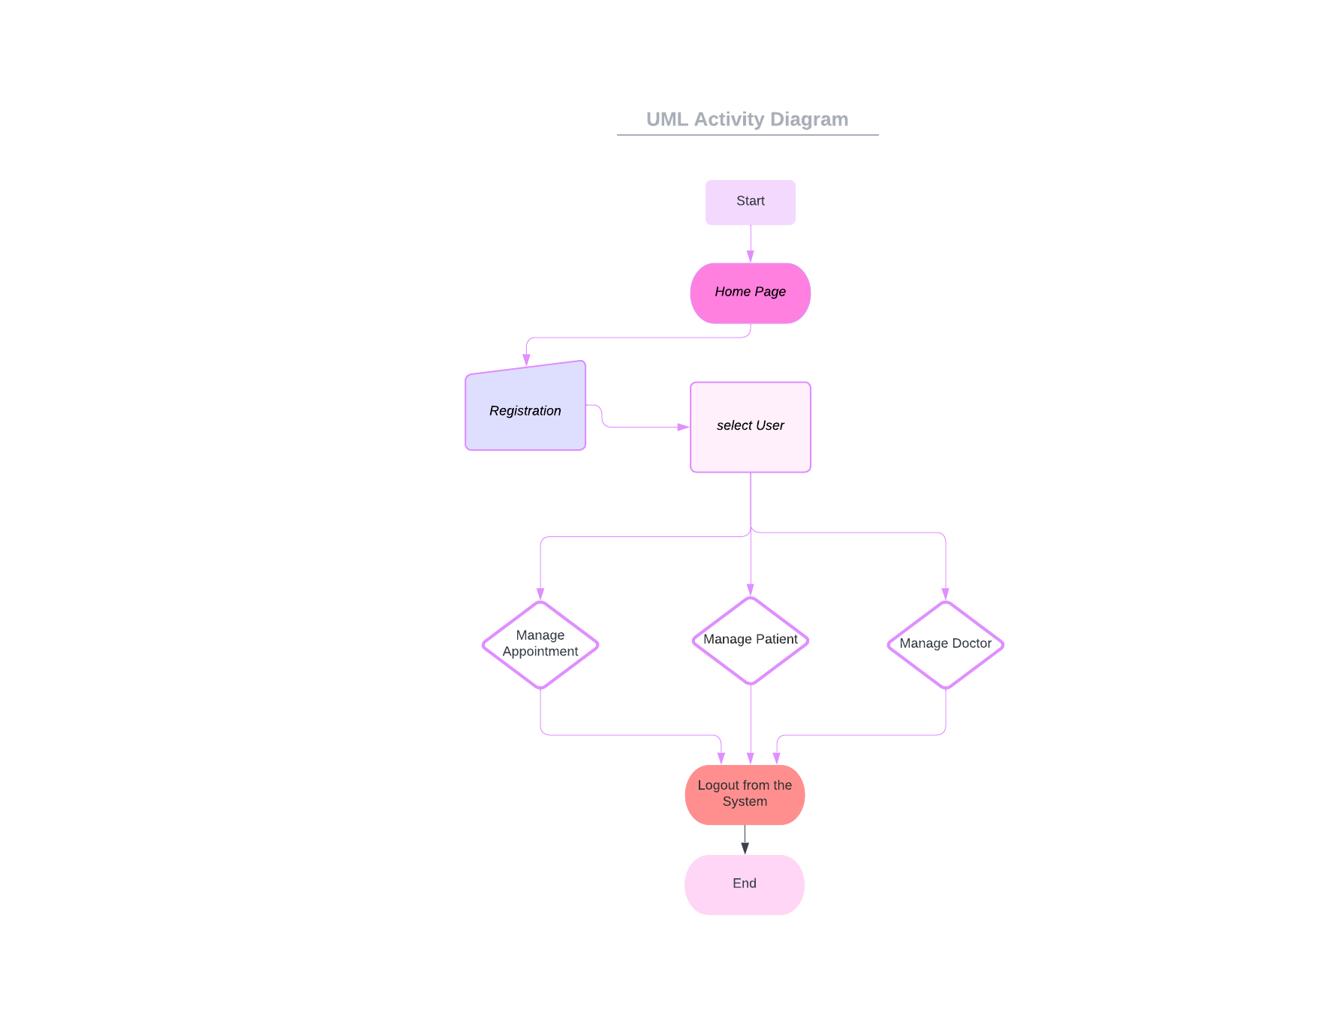
UML Activity Diagram
Initial Node: The diagram starts with an initial node indicating the beginning of the activity flow.
Registration: The first activity is the registration process. It involves capturing such as username, contact information and more.
User Selection: Once the user is registered, the next activity is to select a doctor. This activity involves presenting the user with a list of selected user.
Logout :Logging out with the current user id.

Slide 12





Back-end Development
TECHNOLOGIES:•
Spring Boot: Spring Boot is a Java framework that simplifies the development of stand-alone, production-grade Spring applications. It provides a streamlined setup and configuration process, along with a variety of built-in features and libraries, making it easier to build robust and scalable backend applications.•
Dependencies:
Spring Boot Devtools
Spring Web
MySQL Driver
Spring JPA via Hibernate
Thymeleaf
HIBERNATE

Slide 13




Front-end Development

Slide 14
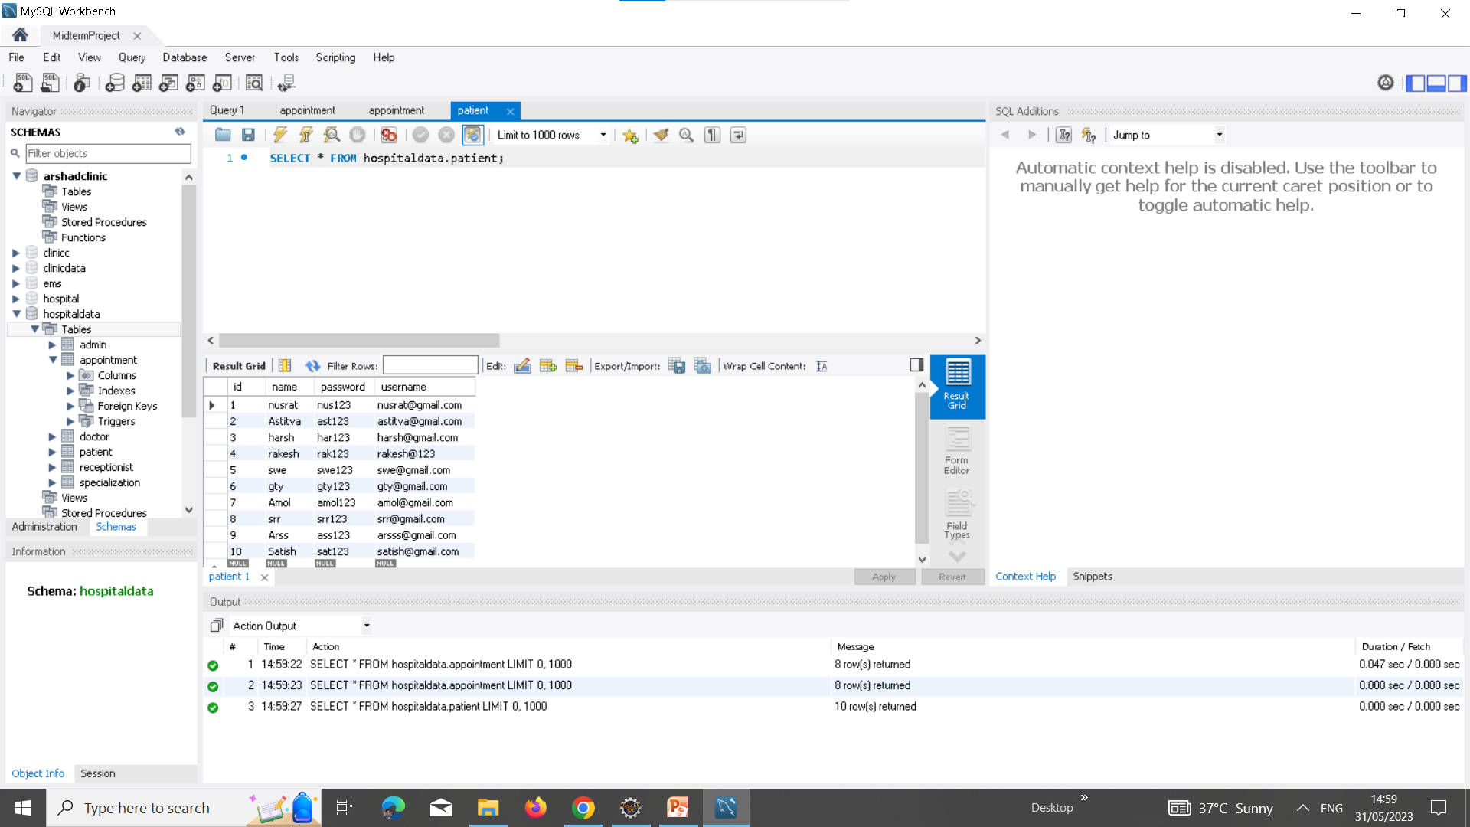
Deployment

Slide 15
Conclusion
The Clinic OPD Booking System is a critical requirement for our healthcare organization to
improve patient care and manage appointments efficiently. The functional and non-functional
requirements outlined in this business requirement document will ensure the successful
implementation and adoption of the system.
Features:-
Patient Appointment booking Features
Receptionist registration features
Admin operation features

Slide 16
Future Work
1. Mobile Application: Develop a mobile application for the Clinic Management System, allowing healthcare providers to access patient information, schedule appointments, and manage clinic operations on-the-go. This can improve accessibility and convenience for clinic staff.
2. Patient Portal: Implement a patient portal that enables patients to securely access their medical records, view upcoming appointments, and communicate with healthcare providers.
3. Advanced Reporting and Analytics: Enhance the reporting and analytics capabilities of the system by incorporating advanced data visualization tools and techniques.
4. Integration with External Systems: Explore integration with external systems, such as electronic health record (EHR) systems or medical billing platforms. This integration can streamline data exchange, improve interoperability, and eliminate manual data entry.
5. Enhancing Security Measures: Continuously update and enhance the security measures of the system to mitigate emerging threats and ensure compliance with data privacy regulations. Regular security audits, and proactive security measures can help protect patient data.

Slide 17
References
https://spring.io/projects/spring-boot
https://www.thymeleaf.org/documentation.html
https://jakarta.ee/specifications/persistence/
https://dev.mysql.com/doc/
https://docs.spring.io/spring-security/site/docs/current/reference/html5/

Slide 18

References

